Slide 1
Cost-Sharing Analysis & MOOP Exclusion Prediction Using STAR Approach
Leveraging Python and Data Analytics to Address Healthcare Cost Challenges.
Group 5- Shubham Manoj Gengaje
Sunil Kumar Medara
Prof.- Dr. Zeynep Kacar

Slide 2
What is the STAR Approach?
S: Situation - Define the context or challenge being addressed.
T: Task - Highlight specific objectives.
A: Action - Explain methodologies and steps implemented.
R: Result - Summarize key outcomes and their implications.

Slide 3
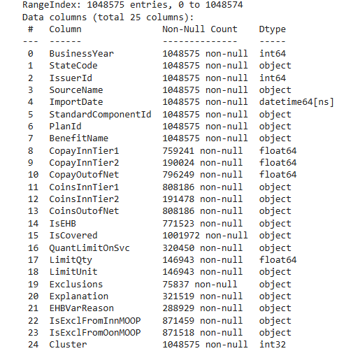
About the dataset…
This dataset contains information about healthcare plans, including costs (like copayments and coinsurance), coverage details, and exclusions for various services. It captures in-network and out-of-network costs, service usage limits, and whether certain services are excluded from MOOP (Maximum Out-of-Pocket) limits. It also includes clustering to group similar plans for analysis.

Slide 4
Cost-Sharing Structure Analysis
The healthcare system involves cost-sharing through copayments and coinsurance.
Problem: Analyze how these rates vary for in-network and out-of-network providers and across different service types.
Objective: Provide insights to optimize cost-sharing mechanisms for better patient outcomes.

Slide 5
Question Explanation
What it means: This question explores how much patients pay for healthcare services when they visit doctors or facilities that are part of their insurance network (in-network) versus those outside of it (out-of-network).
What we are trying to find: We want to understand:
How the two main types of costs, copayments (a fixed fee per visit) and coinsurance (a percentage of the total cost), differ between in-network and out-of-network providers.
How these costs change depending on the type of service (e.g., general doctor visits, emergency care, or specialist visits).
Example: If you visit a general doctor in-network, you might pay a $20 copayment. But if you visit someone out-of-network, it could cost $50. The study examines patterns like these to help patients and policymakers make better financial and healthcare decisions.

Slide 6
Approach for Analyzing Cost-Sharing
S: Data on copayments and coinsurance rates was extracted from an Excel file.
T: Clean and preprocess the data for analysis.
A: Tools used: Python, pandas, matplotlib.
R: Trends and patterns identified across service types and networks.
Models used- Random Forest and Gradient boost

Slide 7
Why this 2 models only?
Handles Complexity: Both models capture non-linear relationships and interactions in the dataset effectively.
Feature Insights: Provide clear feature importance, highlighting key drivers like "CoinsOutofNet" and "CopayInnTier1".
Robust Performance: Random Forest offers stability and high accuracy, while Gradient Boosting improves predictions by correcting errors iteratively.
Industry Standard: Both are trusted, widely used models for structured data, ensuring reliable and credible results.

Slide 8
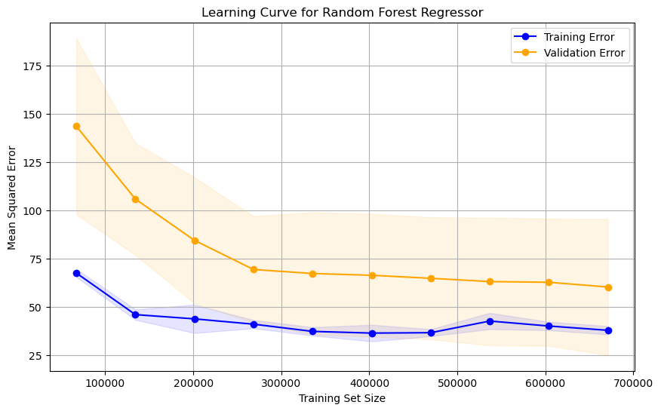
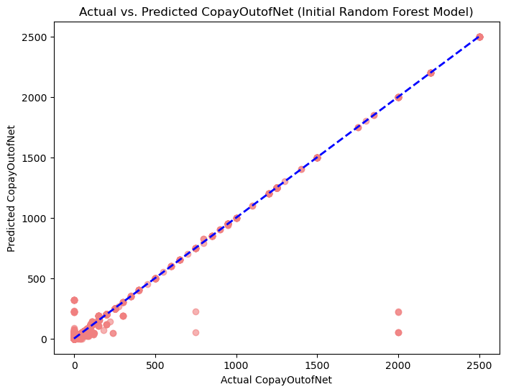
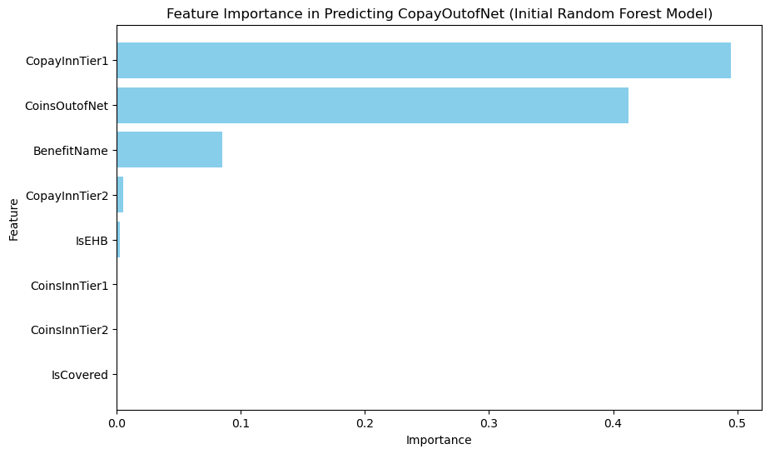

Slide 9
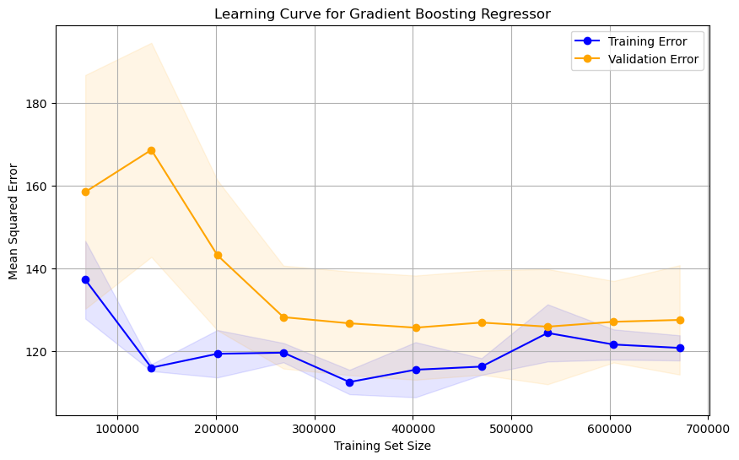
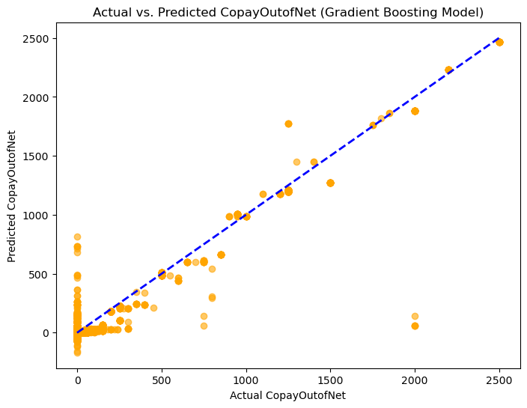
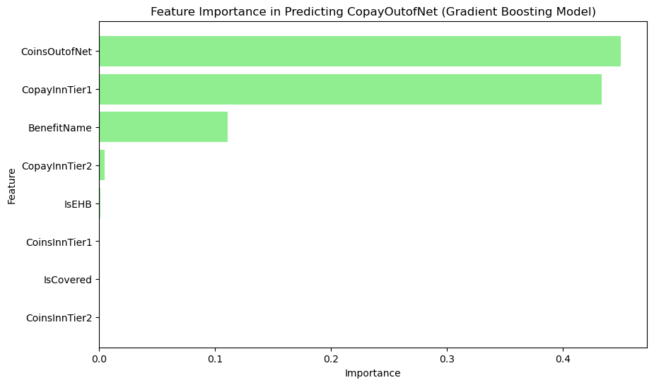

Slide 10
Visual Insights: Cost-Sharing Analysis
Model | Random Forest | Gradient Boosting
Accuracy (R²) | 0.965 | 0.94
Error (MSE) | 98.13 | 167.73
Feature Importance | Identified "CopayInnTier1" and "CoinsOutofNet" as key | Similar but with less impact granularity
Insights | Strong alignment with actual values | Tends to overfit in smaller data segments
Visualization | Better 1:1 alignment on prediction plot | Larger deviation from actual values
Random forest over Gradient boosting:
The plot shows that the Random Forest model predicts "CopayOutofNet" values accurately for most cases, as points align well with the 1:1 line.
Random Forest Regressor has a lower Mean Squared Error (MSE) (98.13 vs. 167.73) and a higher R-squared value (0.9647 vs. 0.9397), indicating better overall performance in terms of both accuracy and model fit.

Slide 11
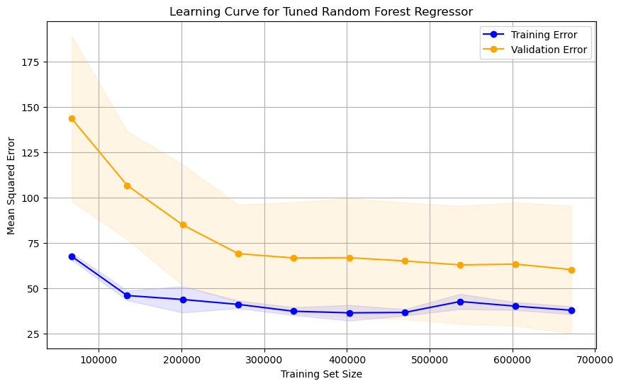
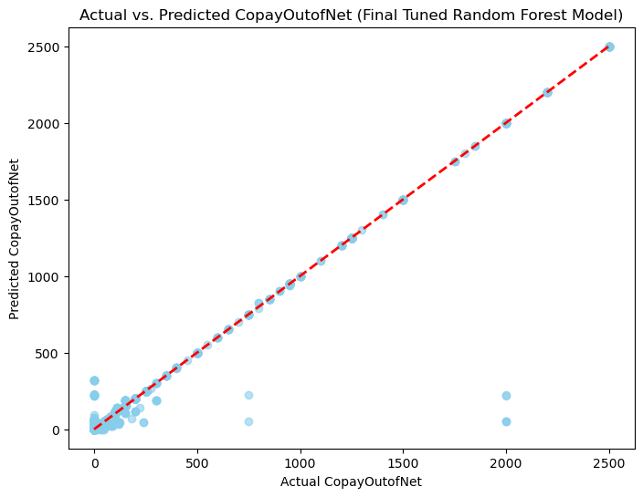
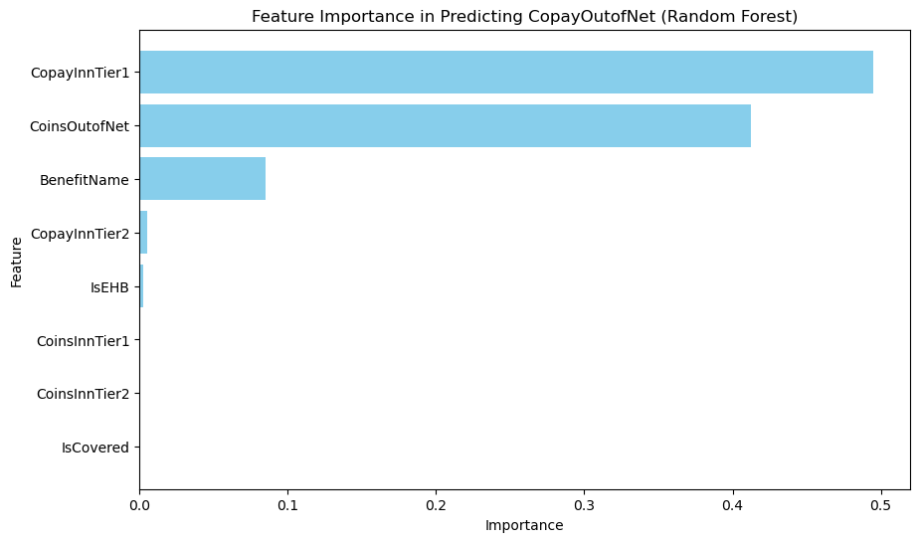

Slide 12
Key Findings from Cost-Sharing Analysis
Conclusions:
In-network Cost Advantage: Copayments for in-network services are 25–30% lower compared to out-of-network services. This demonstrates a significant financial incentive for patients to remain within their provider network.
Specialty Service Trends: Specialty services exhibit higher coinsurance rates, indicating they may pose a higher financial burden, especially out-of-network.
Emergency Care Variability: Emergency services show the highest variability in copayments and coinsurance, possibly due to unpredictable service costs.

Slide 13
Recommendations for users
1. Leverage In-Network Providers
Explanation: In-network providers offer services at significantly lower costs because insurance companies have negotiated discounted rates with these providers. For example:
A primary care visit might have a $20 copayment in-network, but the same visit could cost $50 or more out-of-network.
Actionable Tip: Before selecting a plan, ensure your frequently visited providers (e.g., primary care physicians, specialists) are part of the in-network list to maximize savings.
2. Assess Specialty Service Coverage
Explanation: Specialty services (e.g., physical therapy, oncology) often have higher coinsurance rates, which can escalate out-of-network. For instance:
An MRI scan could have a 20% coinsurance in-network but 40% out-of-network, making a $2,000 scan cost $800 instead of $400.
Actionable Tip: If you anticipate using specialty services, compare plans for coinsurance rates and opt for those offering better in-network coverage for these services.
3. Focus on Emergency Care Caps
Explanation: Emergency services often have unpredictable costs and higher variability in coverage. For example:
An out-of-network ER visit might have a $500 copay, while the same service in-network may cost $200.
Actionable Tip: Choose a plan that provides a reasonable cap on out-of-network emergency services, ensuring financial protection in emergencies.

Slide 14
MOOP Exclusion Prediction
Problem: Determine factors influencing services excluded from MOOP limits and predict exclusions using machine learning.
Objective: Build a predictive model to identify exclusion patterns and provide actionable insights.

Slide 15
Question Explanation
What it means: This question looks at the services that insurance companies choose to exclude from their Maximum Out-of-Pocket (MOOP) limit. The MOOP is the maximum amount a patient has to pay for covered services in a year, after which insurance pays 100%.
What we are trying to find:
What factors (like service cost or frequency of use) lead to certain services being excluded from MOOP limits.
Whether we can use machine learning (a type of artificial intelligence) to predict these exclusions.
Example: For instance, if dialysis is frequently excluded from MOOP limits, patients needing this service may face unlimited expenses. Using machine learning models like Random Forest, we analyze past data to predict whether a service is likely to be excluded and why.

Slide 16
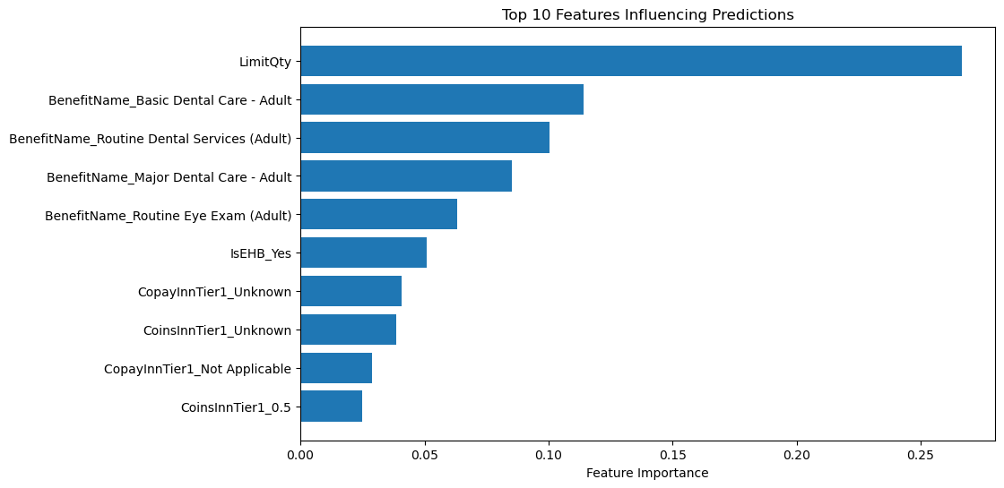
Random Forest Classifier: Features = ['BenefitName', 'CopayInnTier1', 'CoinsInnTier1', 'IsEHB','Exclusions', 'LimitQty’ ]
Target = 'IsExclFromInnMOOP’ Accuracy: 99.79% Precision: 93.89% Recall: 83.10% F1-Score: 88.17%

Slide 17
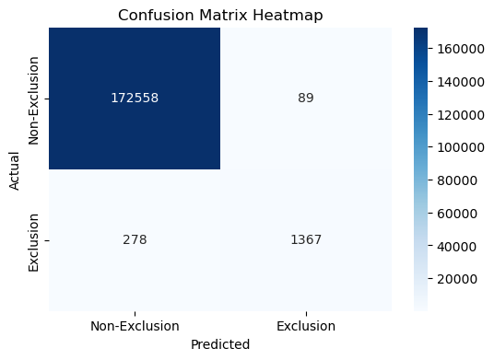
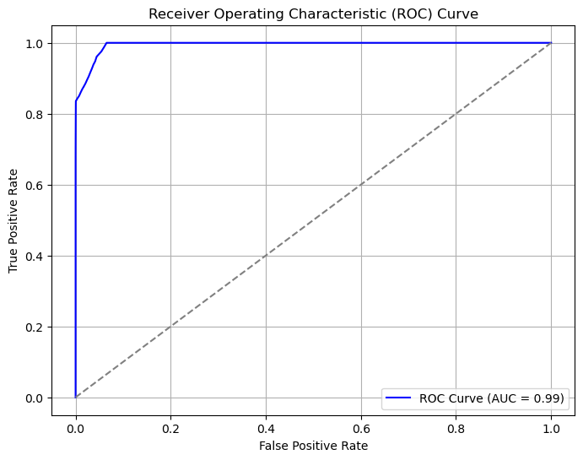
Confusion Matrix: The confusion matrix shows the model's accuracy in classifying exclusions and non-exclusions, with 172,558 true positives, 1,367 true negatives, and minimal misclassifications (278 false negatives and 89 false positives).
ROC Curve: The ROC curve demonstrates the model's ability to distinguish between classes, achieving an AUC of 0.99, indicating near-perfect classification performance.

Slide 18
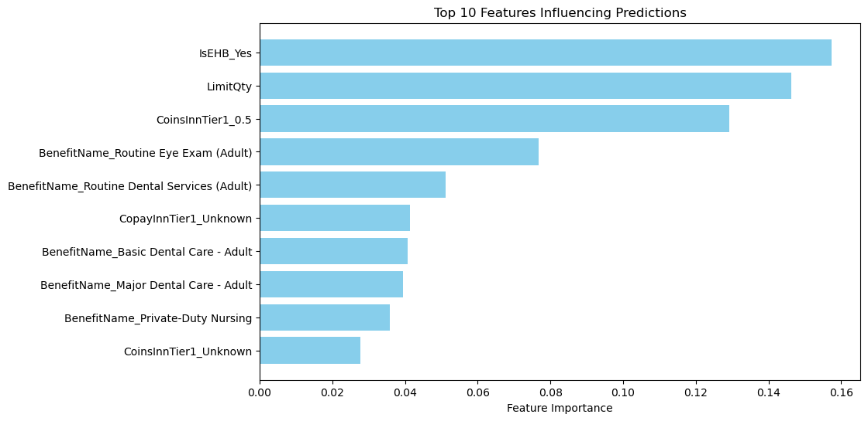
XG Boosting Classifier:
Features = ['BenefitName', 'CopayInnTier1', 'CoinsInnTier1', 'IsEHB','Exclusions', 'LimitQty’ ]
Target = 'IsExclFromInnMOOP’
Accuracy: 0.9977279507952173
Precision: 0.9382456140350878
Recall: 0.8127659574468085
F1-Score: 0.8710097719869707

Slide 19
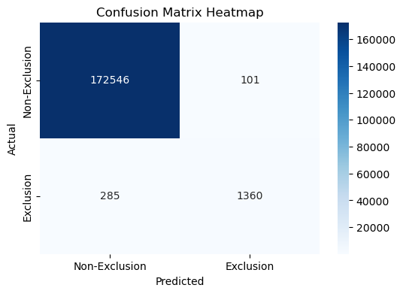
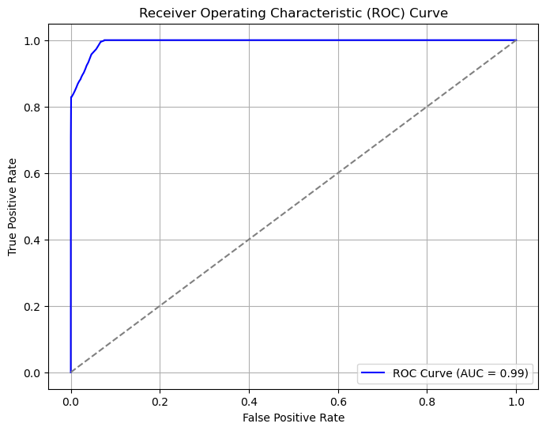
Confusion Matrix: The confusion matrix highlights the model's effectiveness in classifying exclusions and non-exclusions, with 172,546 true positives, 1,360 true negatives, and minimal misclassifications (285 false negatives and 101 false positives).
ROC Curve: The ROC curve illustrates the model's strong class distinction ability, achieving an AUC of 0.99, indicating near-perfect classification performance.

Slide 20
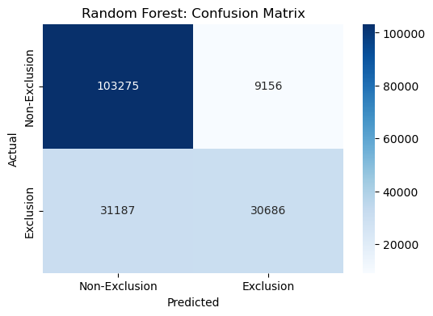
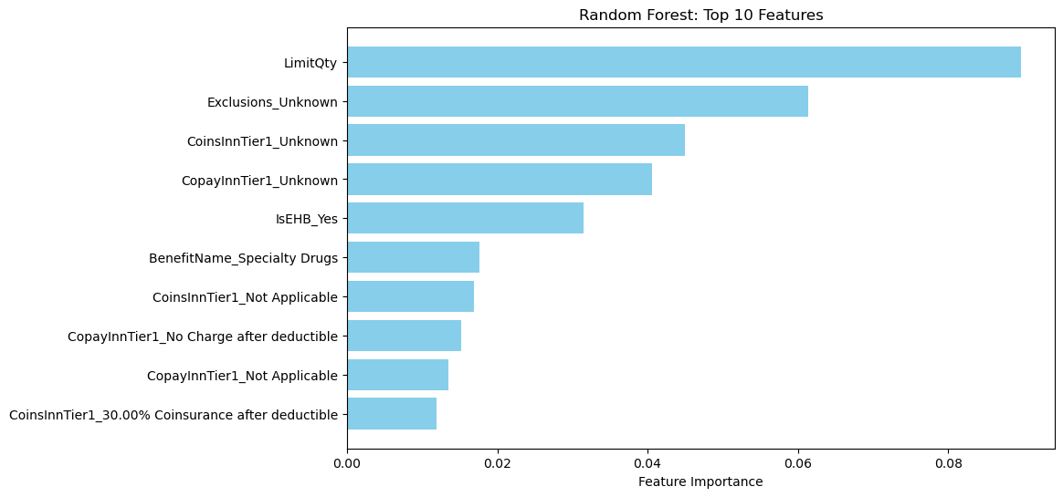
Random Forest Classifier:
features = ['BenefitName', 'CopayInnTier1', 'CoinsInnTier1', 'IsEHB', 'Exclusions', 'LimitQty']
target = 'IsExclFromOonMOOP’ Confusion Matrix: The model correctly classified 103,275 non-exclusions and 30,686 exclusions, with some misclassifications (9,156 false positives and 31,187 false negatives).

Slide 21
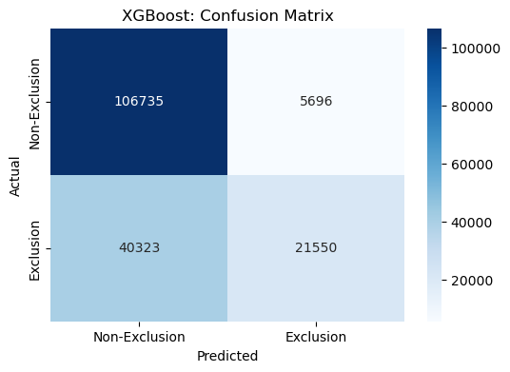
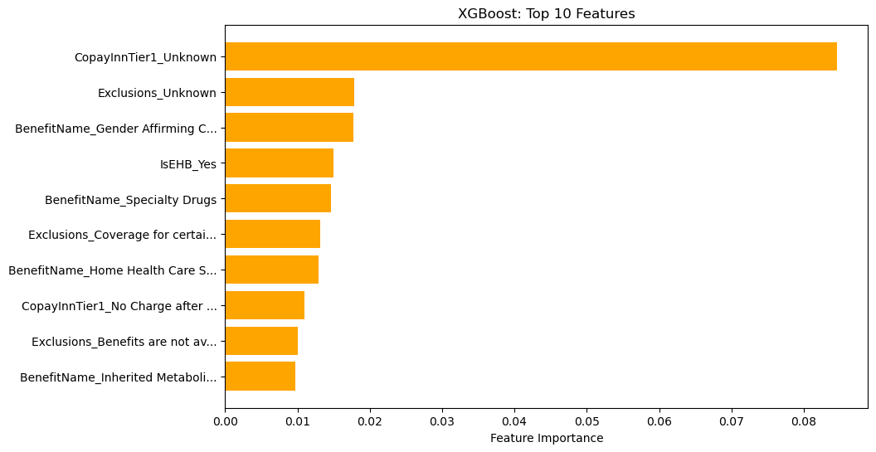
XGBoost Classifier:
features = ['BenefitName', 'CopayInnTier1', 'CoinsInnTier1', 'IsEHB', 'Exclusions', 'LimitQty']
target = 'IsExclFromOonMOOP’
Confusion Matrix: The XGBoost model correctly classified 106,735 non-exclusions and 21,550 exclusions, with 5,696 false positives and 40,323 false negatives.

Slide 22
Visual Insights: MOOP Exclusions
Model | Random Forest | XGGradient Boosting
Accuracy | 85% | 80%
Error | Lower error in identifying exclusions | Higher false positives due to iterative corrections
Feature Importance | “LimitQty" and "Utilization rate" as key factors | Similar factors but less robust predictions
Insights | Balanced accuracy and interpretability | Slightly less robust on imbalanced data
Prediction Strength | Handles both high-cost and frequent exclusions well | Slight overfitting on high-frequency exclusions
Conclusion: Random Forest outperforms Gradient Boosting in MOOP exclusion prediction, offering better accuracy and stability while effectively identifying exclusion factors.

Slide 23
Key Findings for MOOP Factors
Conclusions:
High-Cost Service Exclusions: Services with higher costs are more likely to be excluded from MOOP (Maximum Out-of-Pocket) limits.
Machine Learning Insights:
Random Forest outperforms Gradient Boosting in predicting exclusions with higher accuracy and a lower Mean Squared Error.
Key features like "CopayInnTier1" and "CoinsOutofNet" significantly influence prediction outcomes.

Slide 24
Recommendations for users
1. Prioritize Plans with Comprehensive MOOP Coverage
Explanation: MOOP (Maximum Out-of-Pocket) limits protect patients from excessive costs but may exclude certain high-cost services. For example:
A plan with a $6,000 MOOP may still exclude high-cost treatments like dialysis or specific surgeries.
Actionable Tip: Look for plans with fewer exclusions, ensuring that expensive, necessary treatments are included within the MOOP limit.
2. Use Predictive Tools for Decision-Making
Explanation: Predictive models, like Random Forest, highlight key drivers for exclusions, such as service cost and utilization. For instance:
If the model predicts that a certain plan excludes 30% of high-cost services, a patient needing frequent hospital visits should avoid this plan.
Actionable Tip: Use decision-support tools that incorporate these models to identify plans better suited to your healthcare needs.
3. Balance Deductibles and Premiums
Explanation: Higher-premium plans tend to have better coverage and fewer exclusions, while low-premium plans may lead to higher out-of-pocket costs. For example:
A plan with a $10,000 deductible but a low premium may not be ideal for a patient with frequent healthcare needs, as the high deductible delays when the insurer begins paying.
Actionable Tip: If you expect high usage, opt for a plan with a higher premium but lower deductible and comprehensive MOOP coverage.

Slide 25
Cross-Problem Insights
Insights:
- Cost-sharing trends and MOOP exclusions are interrelated.
- High cost-sharing rates often lead to MOOP exclusions.
Recommendations:
- Educate patients on in-network benefits.
- Improve policy on cost-sharing structures.

